Slide 1

Drugs used in Thromboembolic
Disorders
Dr. Noor Ahmed
Department of pharmacology
3rd year lecture

Slide 2
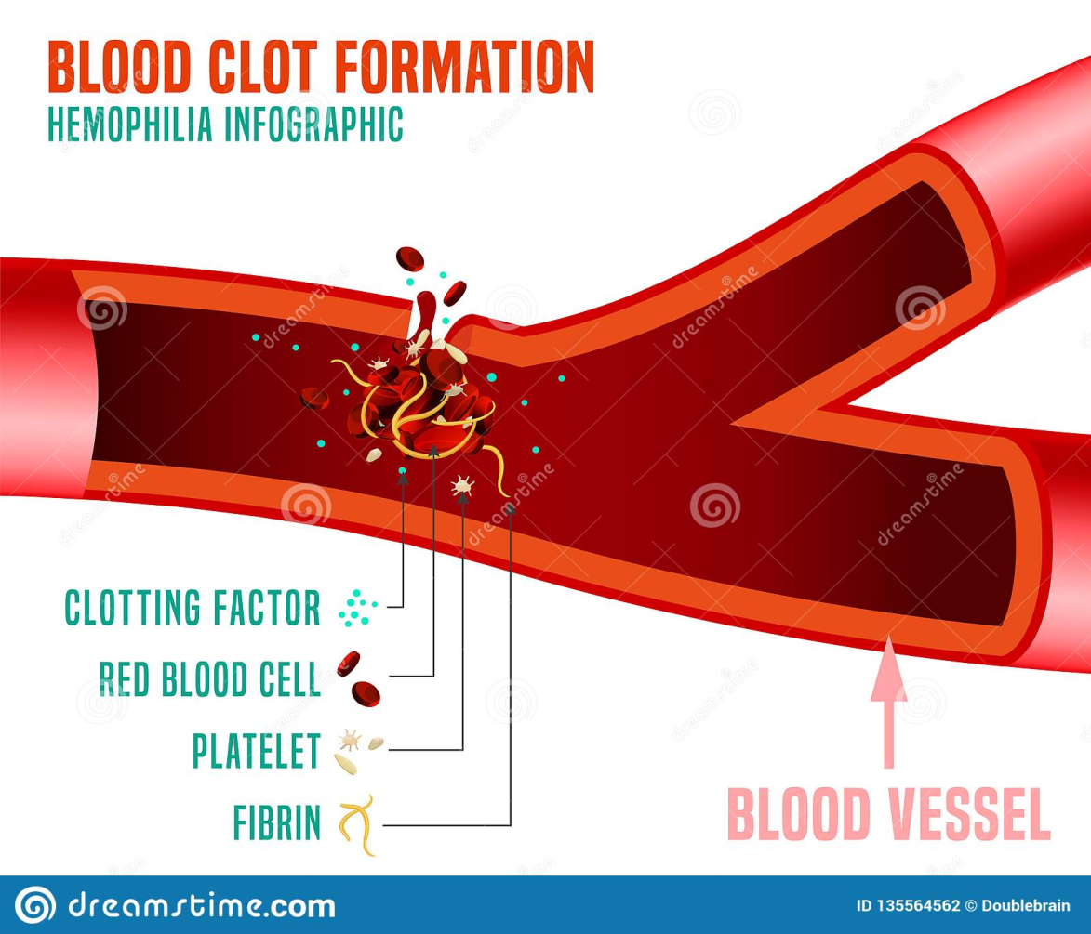
Thrombosis is a pathological condition results in formation of clots despite absence of bleeding.

Slide 3
Drugs for thromboembolic disorders
A-Anti-coagulants
B-Fibinolytic drugs
C-Anti-platelet drugs

Slide 4
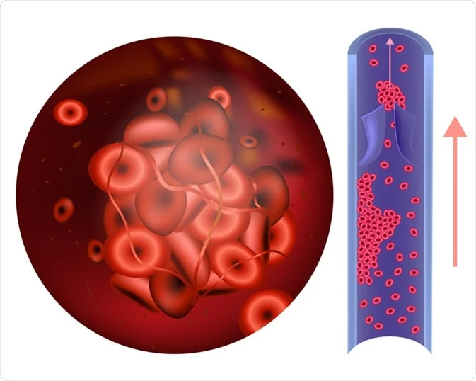
A. Anticoagulants
Drugs that prevent the development and propagation of thrombi by disrupting the
coagulation cascade and suppress production of fibrin.
They are more effective in venous thrombi because
these are mainly composed of fibrin.

Slide 5
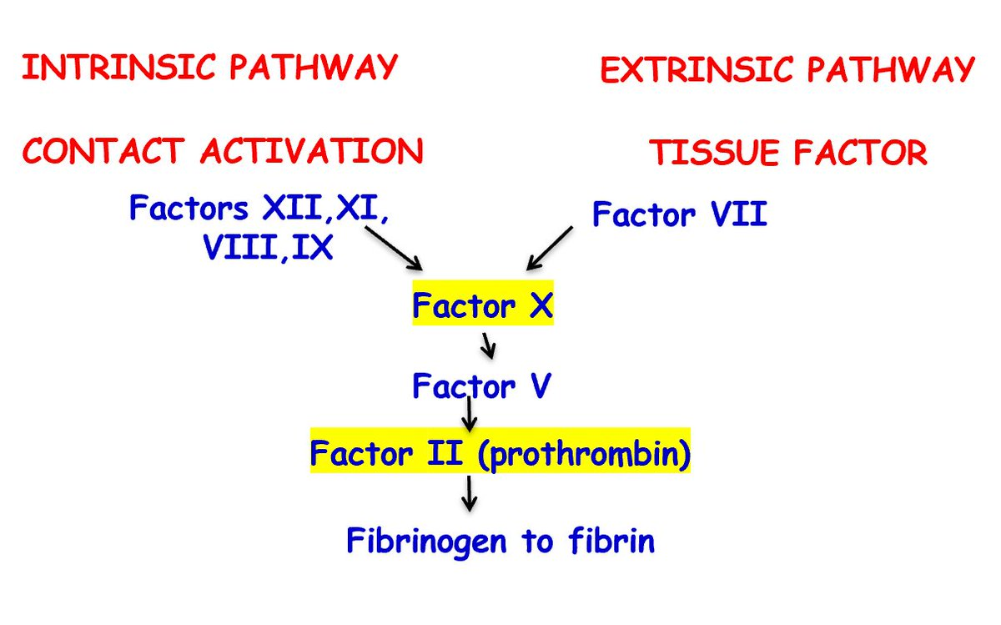
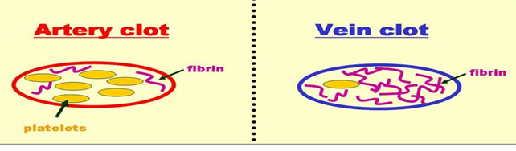
Coagulation pathway
Clot formation

Slide 6
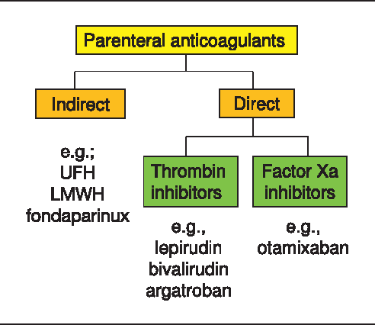
Classification of anticoagulant :
1-parentral anticoagulant drugs
Indirect :
1.Heparin (unfractionated heparin) (UFH) and
Low molecular weight heparins (LMWHs)
ex. enoxaparin
Direct :
-direct inhibitors of thrombin ex. Lepirudin.
-Factor Xa inhibitors eg. otamixiban.

Slide 7
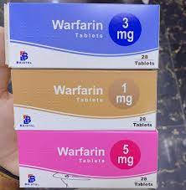
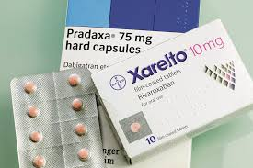
2- oral anticoagulant
1-Coumarin Derivatives e.g. Warfarin
2-Indandione Derivatives e.g. Phenindione is obsolete
because of their allergic toxic effects.
3-Newer anticoagulants
-Direct thrombin inhibitors
Dabigatran etexilate (Pradaxa)
-Direct factor Xa inhibitors
Rivaroxaban (Xarelto)
Apixaban

Slide 8
Parenteral anticoagulants
Heparin as Prototype
Endogenous - strongest organic acid present in the
Body Present in mast cells lungs, liver it is not absorbed from
GIT as it is polar due to its strong negative charges and given (i.v.) and (S.C)

Slide 9
Heparin is an injectable, rapidly acting anticoagulant that is often used acutely to interfere with the formation of thrombi.
Heparin normally occurs as a macromolecule complexed with histamine in mast cells, liver, intestine.
It is extracted for commercial use from porcine intestine. Unfractionated heparin is large of molecular weights ,It is
strongly acidic because of the presence of sulfate and carboxylic acid groups.

Slide 10
Uses of heparin
Heparin is used in the prevention of venous thrombosis and the treatment of a variety of thrombotic diseases, such as pulmonary embolism and acute myocardial infarction.

Slide 11
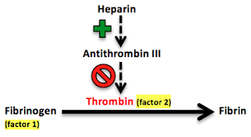
Mechanism of action: Heparin binding to anti-thrombin III (ATIII) endogenous anticoagulant , lead to increase interaction between ATIII and clotting factor Xa converting it to inactivate factor and prevent the conversion of prothrombin to thrombin.

Slide 12
Types of heparin
LMWH-enoxaprin | UFH –heparin
increased inhibitory function of anti-thrombin III to inhibit factor Xa and to lesser degree factor II | Inactivate factors X and thrombin and inhibit conversion of fibrinogen to fibrin | MOA
Injected subcutaneously | it is not absorbed from GIT as it is polar due to its strong negative charges and given intravenous or subcutaneous but not intramuscularly??? | Routes of administration
less protein bound and have Predictable dose response profile fixed t1/2. Dose can be administered according to body weight at home or in out-patient without monitoring | It binds to plasma protein and to sites of endothelial cells and some is excreted by kidney. elimination of heparin :zero-order and first order kinetics (biological t1/2) alters disproportionally with Heparin dose , administration requires hospital admission for adjustment of the dose by monitoring patient’s activated partial thromboplastin time (APTT), to avoid bleeding due to overdose The optimum therapeutic range of APTT is 1.5 – 2.5 times | Elimination
Longer, require once-daily dose | short (6)hours ; necessitates frequent doses | Duration of Action

Slide 13
LMW | UFH
safe | Safe as it cannot pass the placental membrane due to its polarity | Safety during pregnancy
Same but less incidence of HIT and osteoporosis | 1)bleeding 2)Heparin-Induced thrombocytopenia (HIT) characterized by arterial thrombosis and bleeding 3) dose-related Osteoporosis on several months use | Main side effects
Effectiveness of protamine sulphate is unknown | Protamine sulphate: a positively charged basic protein, given i.v. Can bind heparin forming an inactive complex that is excreted. | Antidote If bleeding occur

Slide 14
Uses of (UFH and LMWH) heparin :
1- Acute deep venous thrombosis .
2-prevention of Postoperative DVT and pulmonary embolism in high risk patients i.e. after major abdominal surgery.
3-DVT and pulmonary embolism during pregnancy
4 – Prevention of thrombi in unstable angina and acute myocardial infarction.
5-prevention of clotting in blood samples for laboratory tests as it can prevent clotting in vitro.

Slide 15
Direct inhibitors of thrombin: - ex.Lepirudin:
Inhibits thrombin, by forming irreversible complex with it that is
excreted by kidney.
Use: prevents thrombosis in patient gets heparin induce throbocytopnea HIT.

Slide 16
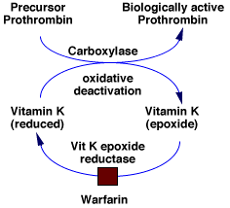
2-Oral anticoagulant
Warfarin
Mechanism of action: Warfarin is structurally similar to vitamin K, It inhibits hepatic synthesis of vitamin K dependent coagulation factors II, VII, IX, and X by competitively inhibits the vitamin K epoxide reducatase complex , an essential enzyme for activating the vitamin K available in the body. Through this mechanism, warfarin can deplete functional vitamin K (reduce form) and thereby stop the synthesis of active clotting factors.

Slide 17
Due to this indirect mode of action, anticoagulation is
delayed until the functioning clotting factors already present in the
circulation have been eliminated; the net result is that anticoagulant
protection is not effective until about 72h after the first dose
If a rapid anticoagulation is required i.e. acute DVT an initial dose of
heparin or LMWH should be used with warfarin for the first 3 days.
The anticoagulant effect also continues for 72 hours after drug
discontinuation till the non-functioning clotting factors are eliminated.

Slide 18
Pharmacokinetics:
Plasma protein binding = 99%; clinical significance:
Drugs as Sulphonamides that displace warfarin from plasma
protein binding sites can increase the anticoagulant effect.
Because the anticoagulant effect of warfarin is directly
related to the plasma concentration, bleeding may occur unless
warfarin dose is reduced.
Metabolism: warfarin is readily absorbed from the GI tract.
It is metabolized by hepatic CP450; enzyme inhibitors as cimetidine metronidazole, and chloramphenicol can increase warfarin plasma
concentration and the anticoagulant effect. Bleeding can occur
unless warfarin dose is reduced.

Slide 19
On the contrary, enzyme inducers as carbamazepine, rifampicin
can reduce the anticoagulant effect, thrombosis may occur unless
the dose of warfarin is increased.
Broad spectrum antibiotics eliminate the intestinal flora that
Synthesize vitamin K and can potentiate the anticoagulant effect of
warfarin.

Slide 20
Dose monitoring:
is by assessing INR (international normalized ratio), which is estimated
from patient’s prothrombin time.

Slide 21
Uses of warfarin because it can be given orally so it is used for
Long term treatment and prevention of :
1. DVT and pulmonary embolism.
2. Thromboembolism associated with prosthetic heart valves
3. Thromboembolism associated with atrial fibrillation.
4. Thromboembolism following myocardial infraction.

Slide 22
Side Effects:
1. Bleeding reversal of anticoagulant effect (antidote for overdose):
vitamin K
2. skin necrosis and ecchymosis
3. Teratogenic: contraindicated during pregnancy as it crosses the
placenta and can cause congenital malformation an increase in the
chance for hemorrhage in both the baby and mother.

Slide 23
Rivaroxaban and apixaban
Mechanism of action: Rivaroxaban and apixaban are oral inhibitors of factor Xa. Both bind to the active site of factor Xa, thereby preventing its ability to convert prothrombin to thrombin .
Therapeutic use:
1-Rivaroxaban is approved for treatment and prevention of DVT
2-prevention of stroke in non-valvular atrial fibrillation.
3-Thrombotic problem in patient with COVID .
Apixaban is used for stroke prevention in non-valvular atrial fibrillation.

Slide 24
Pharmacokinetics: Both drugs are adequately absorbed after oral administration and are highly protein bound. Food may increase the absorption of rivaroxaban.
Side effect :bleeding no available antidote for both drugs.

Slide 25

Contraindications of anticoagulant drugs:
1-in conditions which there is a tendency to bleed such
Hemophilia
2-Thrombocytopenia
3-Severe hypertension
4- Intracranial hemorrhage
5-active peptic ulcer, esophageal avarices and ulcerative colitis
6- Renal or hepatic Impairment
7- Recent surgery to the brain, spinal cord, or eye
8- warfarin during pregnancy and conditions that disrupt
hepatic synthesis of clotting factors as liver disease and alcoholism.

Slide 26


Slide 27
A 60-year old female developed pulmonary embolism postoperatively. Medical therapy started with i.v. injection of a loading dose (10,000 units of heparin) followed by i.v. infusion of 15-25 units/Kg/hr.
1. Why is heparin given and not warfarin?
2. How can you assess your treatment?
3. What possible side effects do you expect, how can you manage?
4. What are the contraindications of anticoagulants therapy

Slide 28
Which of the following drugs is the best outpatient treatment for a pregnant woman in her second trimester who has deep vein thrombosis?
Warfarin
Aspirin
Alteplase
Unfractionated heparin
Enaoxaparin

Slide 29
Regarding warfarin which statement is true?
it maximum anticoagulant effects occur 6 hours following oral intake
its safe anticoagulant during pregnancy
It acts by inhibiting the activation of vitamin K dependent clotting factors
Does not require monitoring during treatment period.
its antagonized by intravenous protamine sulphate

Slide 30
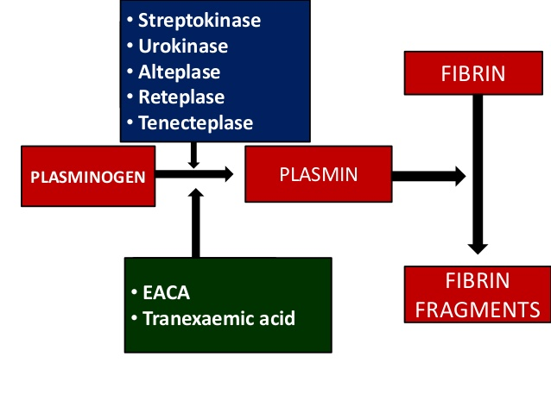
B- Fibrinolytics, thrombolytics
Mechanism of action: They dissolve thrombi by activating plasminogen
leading to formation of plasmin, a proteolytic enzyme that breaks the
insoluble fibrin (the framework of thrombi) to soluble fibrin products.
1-streptokinase
2-urokinase
3-alteplase

Slide 31
Streptokinase: | Alteplase:
Obtained from streptococci | A recombinant human tissue plasminogen activator
binds to circulating plasminogen to form an activator complex which then causes conversion of other plasminogen molecules to plasmin. -Because of this it can cause systemic circulation disturbance and bleeding | specifically activates plasminogen that binds to fibrin in the clot so plasmin is formed and dissolve fibrin locally. -has no effect on circulating systemic coagulation disturbance. It can dissolves aging and resistant
Same uses | Uses: 1-acute myocardial infarction 2-DVT 3- pulmonary embolism 4- Ischemic stroke
Same side effects in addition to hypotension and allergic reactions due to anti streptococcal antibodies | Side effects: 1-Bleeding 2-microemboli dueto disintegration of thrombus
Same | Antidote :Tranexamic acid

Slide 32
C-Antiplatelets
Prevent platelets aggregation. They are used in prophylaxis of arterial
thrombosis because these are mainly composed of platelets.
Aspirin low dose :(80-325 mg/day) inhibits platelets aggregation by
Inhibiting the synthesis of TXA₂ due to irreversible acetylation of
cyclooxygenase.

Slide 33
Clopidogrel(Plavix®):
Its inhibits platelets'ADP receptors that are involved in
binding of platelets to fibrinogen and to each other. It is given once
daily orally and antiplatelets effect lasts 7-10 days.

Slide 34
Dipyridamole (Persantin )
inhibits phosphodiesterase enzyme, so increased platelet c AMP which inhibits platelet aggregation.
Epoprostenol (prostacyclin): stimulates adenylcyclase enzyme,
thereby increased cAMP formation which inhibits platelet
aggregation.

Slide 35
Abciximab: monoclonal antibody that blocks platelet GP IIb/IIIa
receptors that is involved in the final step binding of platelets
to fibrinogen.

Slide 36
Uses of anti-platelets :
1.prevention of M.I in patient with atherosclerosis or unstable angina.
2. prevention of recurrence of MI.
3. cerebral ischemic attacks
4. atrial fibrillation
5. coronary artery grafting

Slide 37
Drugs used to control bleeding
Transxamic acid
Mechanism of action: competitively inhibits binding of plasminogen to
tissue plasminogen activator so prevents conversion of plasminogen to
plasmin, thus prevents fibrinolysis .
Uses: Bleeding due to
1-overdose of fibrinolytics
2- thrombocytopenia
3-haemophili
4- prevention of hyperplasminaemic bleeding that results from
damage to tissues rich in plasminogen activators i.e. after prostatic
surgery, tonsillectomy, uterine cervical biopsy , menorrhagia and
bleeding due to intrauterine contraceptive device

Slide 38
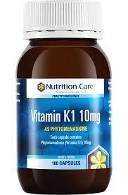
Vitamin K preparations:
Vitamin K1: is a fat soluble vitamin, requires bile salt for absorption if
given orally and can be given I.M, S.C and I.V.
Rapid intravenous injection cause anaphylactic reactions with dyspnea,
chest tightness, back pain and even death.

Slide 39
Uses of vitamin K1:
1.Dietary vitamin K deficiency
2. Haemorrhagic diseases of newborns
3. warfarin overdose . It Stops bleeding in 12 h.

Slide 40
Vitamin K3 (menadiol) is a water soluble synthetic analogue, and takes 24 hours to act,
but its effect lasts several days, can be given orally, I.M, and I.V.
Use: hypoprothrombinaemia due to malabsorption
Side effects: hemolytic anemia in G6PD deficient patients and
neonates.

Slide 41
-All the following drugs inhibit platelets aggregation except:
Low dose aspirin
Clopidogrel
Tranexamic acid
Dipyridamole
abciximab

Slide 42
A 35-year old woman suffered from menorrhagia after inserting IUCD (Intrauterine contraceptive device). The doctor prescribed to her antibiotics and other drugs
What are the drugs that stop bleeding in general? How do they act?
2. What are their other clinical inductions?

Slide 43


